Slide 1


Major Project Phase-2
CLASSIFICATION OF TWO – WHEELER USING
DEEP LEARNING
Presented by :
J. Tejaswini (19211a0470)
P. Charitha (19211a04F8)
K. Sahithi (20215a0416)
K. Varshith (19211a0477)
Under the Supervision of
Dr. Syed Abudhagir Umar
Associate Professor

Slide 2
Content
Abstract
Introduction
Literature Survey
Project objectives
Proposed Methodology
Project Outcomes
References

Slide 3
Abstract
Intelligent transportation monitoring requires the accurate identification of moving vehicles. Vehicle classification has several applications in urban areas and intelligent transportation. Nowadays, a number of deep neural networks have been developed for object classification. This paper provides an extensive analysis of current YOLO-based vehicle recognition and surveillance techniques. Comparing the YOLO approach to all other object detection algorithms reveals a number of its benefits. In contrast to other algorithms, YOLO totally examines the video frame by determining the bounding boxes by the convolutional neural network, determining the probability for each class, and detecting the image more quickly. Whereas other algorithms do not analyze the complete image. We have used this algorithm to classify the two-wheeler vehicle into two classes such as scooter or bike and implement the model in real-time traffic conditions and obtain more accuracy.

Slide 4
Introduction
Vehicle classification in videos has broad application in intelligent transportation and smart cities. Humans visual system is fast and precise and can perform complex tasks like identifying things etc.. But in computer vision object recognition is one of the major challenge. This is called Object detection.
Neural Networks in Machine Learning, called Deep Learning that teaches computers to process data in a way i.e., inspired by the human brain. In our model, we use YOLOV5 for object detection that can accurately and quickly predict the locations of different objects. The output will be the classification of a two-wheeler into bike and scooter.

Slide 5
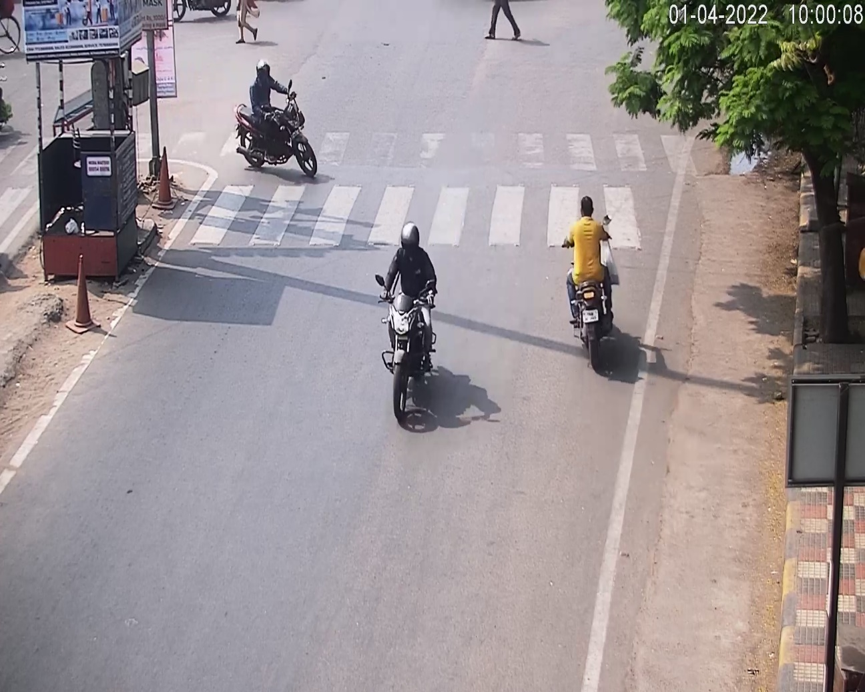
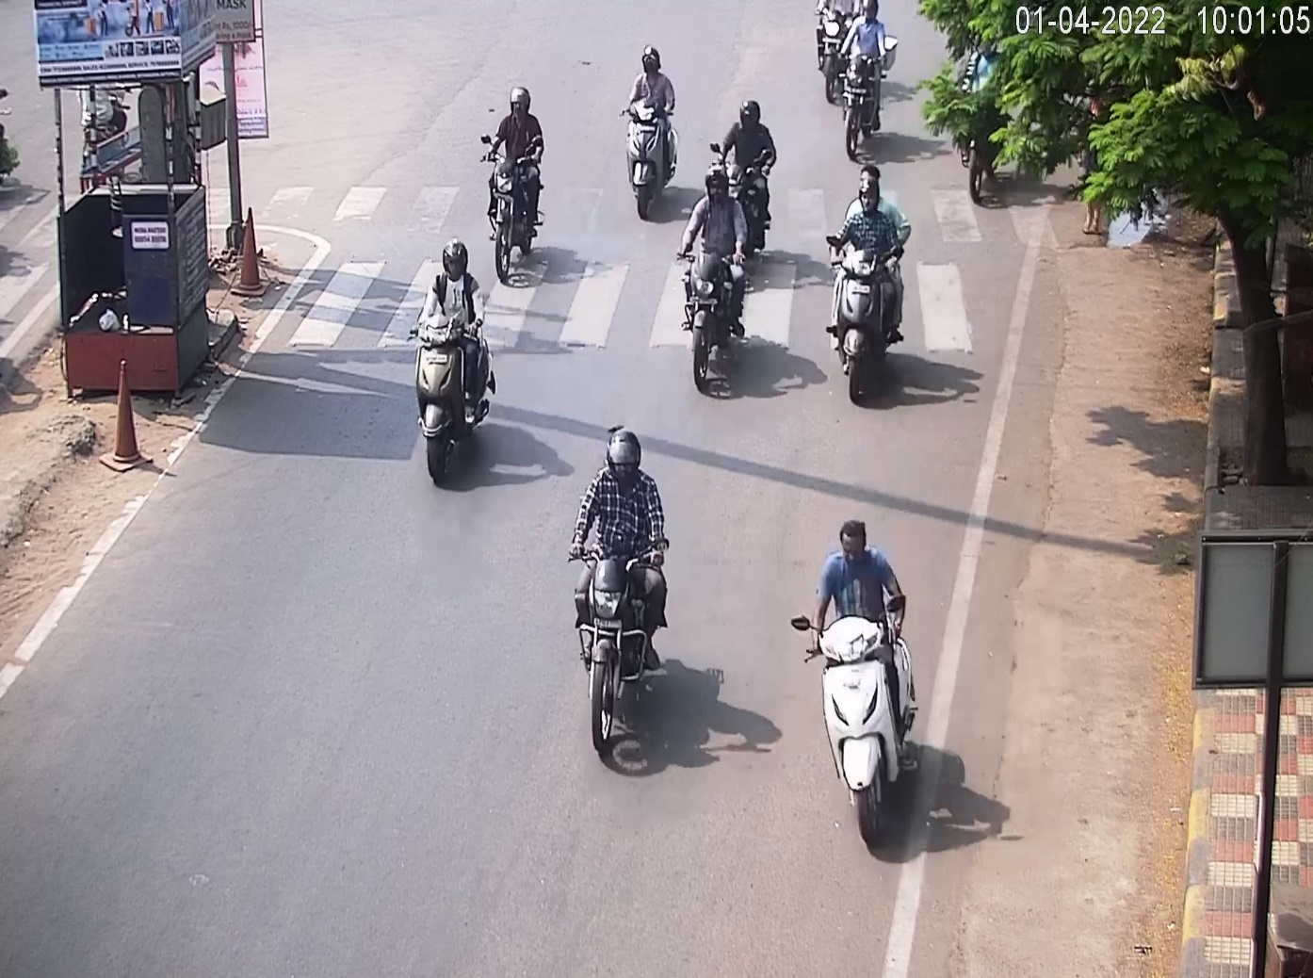
Input Images

Slide 6
Literature Survey
S.No. | Title of the Paper | Authors | Volume/Issue No/Year | Findings/Observations | Research gap/Scope/Parameters considered
1 | Vehicle Detection Using Image Processing and Fuzzy Logic | Isha Jain , Babita Rani | Volume- 01, Issue No – 02, December 2010. | Classification of vehicles is done based on the size and shape of vehicles. The image is pre-processed, detected and classified using fuzzy logic. The unwanted size of objects are removed. | Binary Opening, Image Pre-processing, Vehicle Detection.
2 | An Improved Faster R-CNN for Small Object Detection | Bo Wang, Changqing cao, Wenrui Zhang | Volume – 07, Year - 2019 | Overcoming the low resolution, complex background problems faced with CNN by improving the algorithm based on faster R-CNN (Region based) using the two-stage detection idea. This algorithm is an effective way to detect small objects. | Faster R-CNN, CNN, Small Object Detection.

Slide 7
S.No. | Title of the Paper | Author with Affiliation | Volume/Issue No./Year | Findings/Observations | Research gap/Scope/Parameters considered
3 | Literature Survey on object detection using YOLO | Dr. G. N. Srinivasan, Athiya Marium, Supreetha A. Shetty | E-ISSN : 2395-0056, Volume – 7 , Issue – 6 , June 2020 | The various modifications done to YOLO network which improves the efficiency of object detection. | Object Detection, YOLO, Obstacle detection.
4 | Real-time Traffic sign recognition using YOLOV3 | V. Vijayaraghavan, M. Laavanya | E-ISSN: 2249 – 8958, Volume-9 Issue-1S5, December, 2019 | The approach is for traffic sign detection and classification using YOLO. The YOLO model is used for sign board detection and a CNN model is used to classify the identified sign. | Number of images, Annotation using Roboflow

Slide 8
S.No. | Title of the Paper | Author with Affiliation | Volume/Issue No./Year | Findings/Observations | Research gap/Scope/Parameters considered
5 | Real-time object detection using YOLOV3. | Omkar Masurekar, Prateek Kulkarni, Shubham Patil. | E-ISSN: 2395-0056, Volume-07, Issue – 03, March 2020. | To detect multiple number of images in a frame using web-cam and android camera. | Deep learning Bounding Box, Anchor box, YOLOV3.
6 | Pedestrian, bike and vehicle classification using Deep Learning. | Yen-Yi Wua and Chun- Ming Tsaib. | Volume-5 ,October,2013 | The results demonstarte that the proposed image preprocessing method and the DBN architecture can achive higher classification accuracy rate in 1000 training set. | Vehicle classification ,image detection,small training set.

Slide 9
S.No. | Title of the Paper | Author with Affiliation | Volume/Issue No./Year | Findings/Observations | Research gap/Scope/Parameters considered
7 | Deep Learning for image classification and object segmentation. | Hao Wu, Qi Liu, Xiaodong Liu. | Volume – 60, Issue no – 02, Year – 2019. | Deep learning models are compared with several Neural Networks, and deals with image classification, object detection and image segmentation. | Image Classification, Object Segmentation, Object Detection, Convolutional Neural Network.
8 | Non-parametric weighted Feature Extraction for Classification. | Bor-Chen Kuo, D.A. Landgrebe. | Volume – 42, Issue no – 5, May 2004. | The transformation of raw data into numerical features that can be processed while preserving the information in the original data set. It yields better results than directly applying the raw data. | Dimensionality reduction, feature vector, classification, non parametric feature extraction.

Slide 10
S.No. | Title of the Paper | Author with Affiliation | Volume/Issue No./Year | Findings/Observations | Research gap/Scope/Parameters considered
9 | Comparision of CNN and YOLO for Object detection. | Yong-Hwan lee, Youngseop kim . | Volume – 19, Issue - 01, March 2020. | The comparison of CNN and YOLO based on its accuracy, speed and cost for Object Detection. | CNN, YOLO, Computer Vision, Object detection.
10 | Sentiment Classification: Noisy data, large feature vectors. | Michael Gamon. | December 2004 | The feature extraction in a noisy data set. Even though the data is very noisy we can use large feature vectors with feature reductions we can achieve high classification accuracy. | Feature Vector, Support Vector Machine(SVM), Classification.

Slide 11
S.No. | Title of the Paper | Author with Affiliation | Volume/Issue No./Year | Findings/Observations | Research gap/Scope/Parameters considered
11 | Classification and tracking for transportation using YOLOv2. | Kavitha N, Chandrappa D.N. | 2021 | An optimized YOLOv2 model for counting detected and classified vehicles. To accurately predict and locate vehicle objects, Rk -means++ clustering to select six anchor boxes of different sizes. | Deep learning techniques Optimized YOLOv2 algorithm COCO dataset SORT algorithm Vehicle classification.
12 | Vehicle Classification framework. | Mircea Nicolescu , George Bebis and Monica Nicolescu . | January - 2014 | They used six different approaches to classify vehicles. The dataset that we used contains the images of vehicles taken from a surveillance video camera and segmented using a tracking algorithm . The images were taken such that vehicles are captured in a more general oblique view instead of side or top view. | Computer vision, Video surveillance, Pattern recognition, Traffic monitoring, Vehicle classification, Machine vision and scene understanding, Image Processing .

Slide 12
S.No. | Title of the Paper | Author with Affiliation | Volume/Issue No./Year | Findings/Observations | Research gap/Scope/Parameters considered
13 | Vehicle detection approach for insufficient conditions and night time illumination condition. | Ho Kwan Leung, Xiu-Zhi Chen, Chao-Wei Yu, Hong-Yi Liang, Jian-Yi Wu and Yen-Lin Chen . | November 2019 | A deep-learning-based vehicle detection technique that can achieve effective detection performance under extreme illumination conditions. The technique can be used in on-road driver assistance tools and autonomous vehicles. | Vehicle detection, deep learning, night time surveillance, convolutional neural networks, insufficient lighting, real-time detection, residual architecture.
14 | Vehicle detection and classification using Pixel- wise code exposure measurements. | Chiman Kwan, David Gribben, Bryan Chou, Bence Budavari, Jude Larkin, Akshay Rangamani, Trac Tran, Jack Zhang and Ralph Etienne-Cummings . | June 2020 | They present a real-time framework for vehicle detection and classification directly by using the compressive measurements collected via pixel-wise code aperture cameras. The PCE camera utilizes a compressive sensing scheme that condenses multiple frames into a code aperture frames and saves power and bandwidth by individually controlling the exposure times of pixels. | Real-time object detection, deep learning, detection, classification, wireless, compressive measurements.

Slide 13
S.No. | Title of the Paper | Author with Affiliation | Volume/Issue No./Year | Findings/Observations | Research gap/Scope/Parameters considered
15 | Vehicle classification using convolutional neural networks. | Xinchen Wang1, Weiwei Zhang1 , Xuncheng Wu1, Lingyun Xiao2 , Yubin Qian1 , Zhi Fang. | August 2017 | The region proposal algorithm, which is region proposal network (RPN). The RPN shares the convolutional layer parameters with object detection network. | Convolutional neural network Vehicle type classification Deep learning Intelligent transportation system Object detection.
16 | Vision-based vehicle detection and counting system using deep learning in highway scenes. | Huansheng Song, Haoxiang Liang, Huaiyu Li, Zhe Dai and Xu Yun. | 2019 | This study established a high-definition vehicle object dataset from the perspective of surveillance cameras and proposed an object detection and tracking method for highway surveillance video scenes. A more effective ROI area was obtained by the extraction of the road surface area of the highway. | Vehicle dataset, Image segmentation, Vehicle detection, Vehicle counting, Highway management.

Slide 14
S.No. | Title of the Paper | Author with Affiliation | Volume/Issue No./Year | Findings/Observations | Research gap/Scope/Parameters considered
17 | Deep Learning-Based Vehicle Classification for Low Quality Images. | Sumeyra Tas, Ozgen Sari, Yaser Dalveren, Senol Pazar, Ali Kara and Mohammad Derawi. | June 2022 | A simple convolutional neural network (CNN)-based model for vehicle classification in low resolution surveillance images collected by a standard security camera installed distant from a traffic scene. In order to evaluate its effectiveness, the proposed model is tested on a new dataset containing tiny (100 × 100 pixels) and low resolution (96 dpi) vehicle images. | Vehicle classification, convolutional neural network, deep learning, low resolution, low quality.
18 | Moving Vehicle Detection and Classification Using Gaussian Mixture Model and Ensemble Deep Learning Technique. | Preetha Jagannathan, Sujatha Rajkumar , Jaroslav Frnda , Parameshachari Bidare Divakarachari , and Prabu Subramani. | May 2021 | An ensemble deep learning technique is proposed for vehicle type classification which was primarily used for traffic surveillance systems. | Ensemble Learning, MATLAB, Deep Neural Networks.

Slide 15
S.No. | Title of the Paper | Author with Affiliation | Volume/Issue No./Year | Findings/Observations | Research gap/Scope/Parameters considered
19 | Automatic Vehicle Identification and Classification Model Using the YOLOv3 Algorithm for a Toll Management System. | Sudhir Kumar Rajput,Jagdish Chandra Patni,Sultan S.Alshamrani,Vaibhav Chaudhari, Ankur Dumka, Rajesh Singh, Mamoon Rashid , Anita Gehlot and Ahmed Saeed AlGhamdi. | July 2022 | They tested a custom-trained YOLOv3 algorithm at toll plazas, on highways and in urban areas. The results showed an average precision of 94.1% and an average recall of Sustainability 2022, 14, 9163. 14 of 15 86.3% at the toll plazas. With good precision and recall at the toll plazas, the algorithm can be used for AVI and AVC in a toll management system at the toll plazas, while for use in applications related to an ATMS and an urban area, the algorithm requires more research. | Smart transportation, vehicle identification, vehicle classification, YOLOv3.
20 | Vehicle detection and classification over the video streams. | Seda Kul, Suleyman Eken and Ahmet Sayar. | June 2017 | They proposed a general framework for real-time topic based pub/sub systems. They also proposed a distributed real-time framework for vehicle detection and classification over the surveillance video streams. | Dimensionality reduction, vehicle detection and classification, intelligent traffic management systems, video processing.

Slide 16
S.No. | Title of the Paper | Author with Affiliation | Volume/Issue No./Year | Findings/Observations | Research gap/Scope/Parameters considered
21 | Ensemble Vehicle Detection Method Based on Single-Stage and Two-Stage Deep Learning Models. | Hai Wang, Yijie Yu, Yingfeng Cai Xiaobo Chen, Long Chen, and Yicheng Li. | 2020 | This paper first explores the detection accuracy and detection speed of the seven mainstream deep learning object detection algorithms through multiple experiments using the KITTI dataset evaluation standard. | Deep learning, ensemble method, object detection
22 | Vehicle Classification with Deep Learning . | Watcharin Maungmai , Chaiwat Nuthong. | 2019 | CNN is proposed as a type and color classifiers to classify vehicle characteristics from vehicle image which systematically cropped by machine. The experiment’s results show that CNN outperforms other methods in type classification. | Vehicle classification, size classification, color classification, deep learning, convolutional neural network.

Slide 17
S.NO. | Title of the Paper | Author with Affiliation | Volume/Issue No./Year | Findings/Observations | Research gap/Scope/Parameters considered
23 | Deep reinforcement learning with visual attention for vehicle classification . | Dongbin Zhao, Yaran Chen and Le Lv. | 2016 | They taken CNN as the evaluation network. With the multiple convolutional layers and down-sampling layers, CNN can automatically learn the useful representation for the classification target. | Visual attention, convolutional neural network,reinforcement learning, vehicle classification.
24 | Real-Time Vehicle Classification and Tracking Using a Transfer Learning-Improved Deep Learning Network. | Bipul Neupane, Teerayut Horanont and Jagannath Aryal | 2022 | Vehicle detection and classification using deep learning (DL) and multi-object tracking (MOT) on video streams obtained from a network of surveillance cameras have become the state of the art (SOTA) in the automation of intelligent transport systems (ITSs). | In future work, we plan to validate the speed of the vehicles and compare the effects of Internet network speed, from 4G to 5G, on the use of DL models for road safety, and we also want to add license plate.

Slide 18
Project Objectives
The present work has been planned to fulfil the following objectives:
1. Identify the two-wheeler vehicles by creating bounding boxes
(object detection).
2. Classify the identified image into Bike or Scooter.
3. Evaluate the model accuracy of YOLOV5 and testing the model on various classes.

Slide 19
Proposed Methodology
Gathering required Video Data
Frames are annotated with makesence.ai tool
Preparing the dataset
Generate frames from input video
Obtaining the classification output
Training the yolov5 model with the dataset
Deploying the dataset into yolov5 model
Testing the model

Slide 20
Yolov5 Model
YOLOv5 is a new-generation target detection network of the YOLO series. It is a product of continuous integration and innovation based on YOLOv3 and YOLOv4. Secondly, YOLOv5 has achieved better results in PASCAL VOC and COCO object detection tasks; so, this article uses the YOLOv5 detection network to detect the construction workers’ helmet wearing.
The YOLOv5 object detection network official gave four network models: YOLOv5s, YOLOv5m, YOLOv51, and YOLOv5x. The three models of YOLOv5m, YOLOv51, and YOLOv5x are the products of continuous deepening and widening based on YOLOv5s. The YOLOv5 network structure is divided into four parts: input, backbone, neck, and prediction.

Slide 21
Training the model:
The major aim of the project is to improve the training capability of the YOLOV5 model to work accurately on real-time traffic conditions and for that purpose we are training the model for the particular classes of bike and scooter.
The extracted frames are annotated using Makesense.ai tool and the labels of the annotated image are exported.
The image dataset is divided into training, validation and testing dataset and exported to the Google colab.
The YOLOV5 model is installed and the dataset is deployed in the training model and the model is trained until a better accuracy is obtained with test data.
Once the training of the model is done the video file is imported into the yolov5 environment and the target class is detected in every layer of the video file.

Slide 22
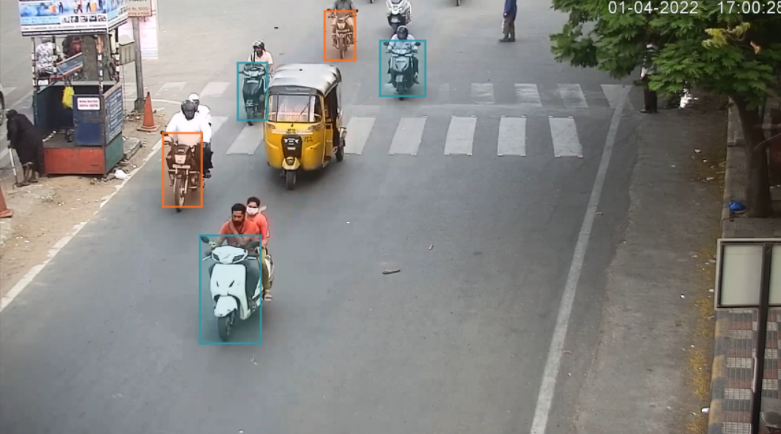
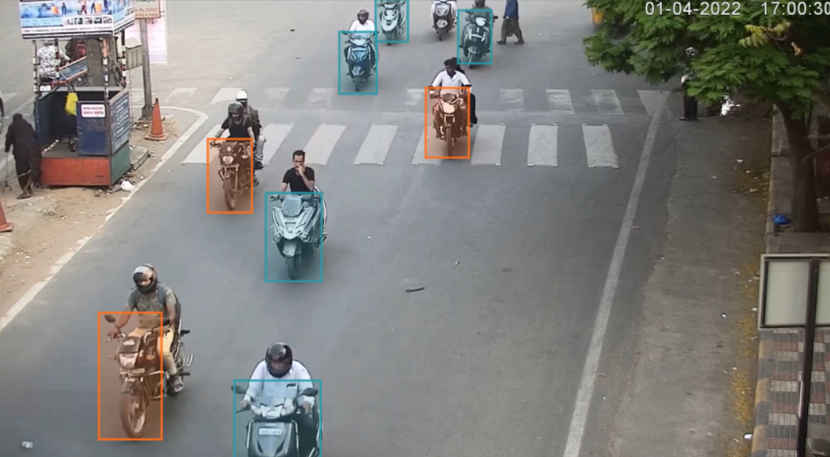
Annotated Images

Slide 23
Project outcomes
1. Classification of Two-wheeler Vehicle.
2. Get the better accuracy in real- time traffic conditions.

Slide 24
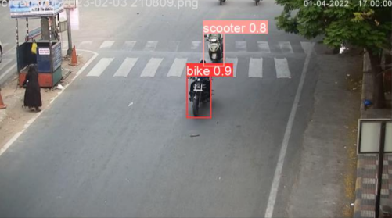
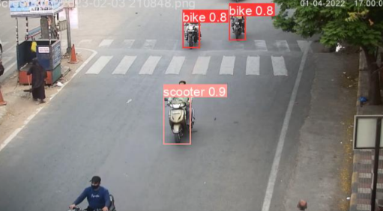
Output Images

Slide 25
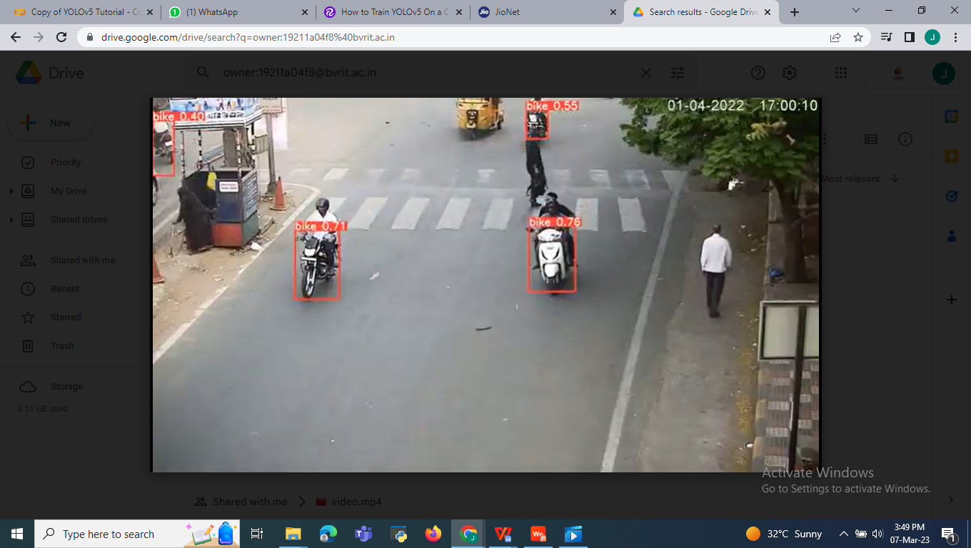
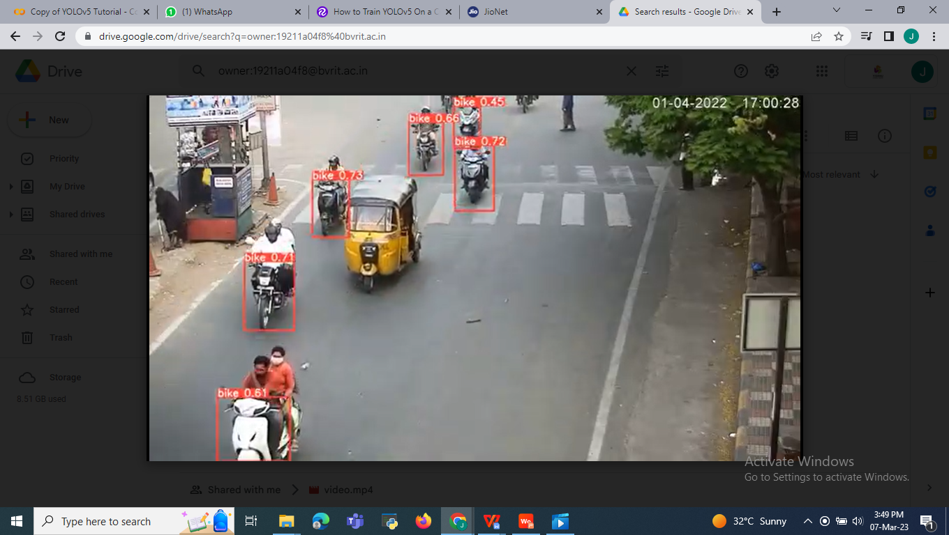

Slide 26
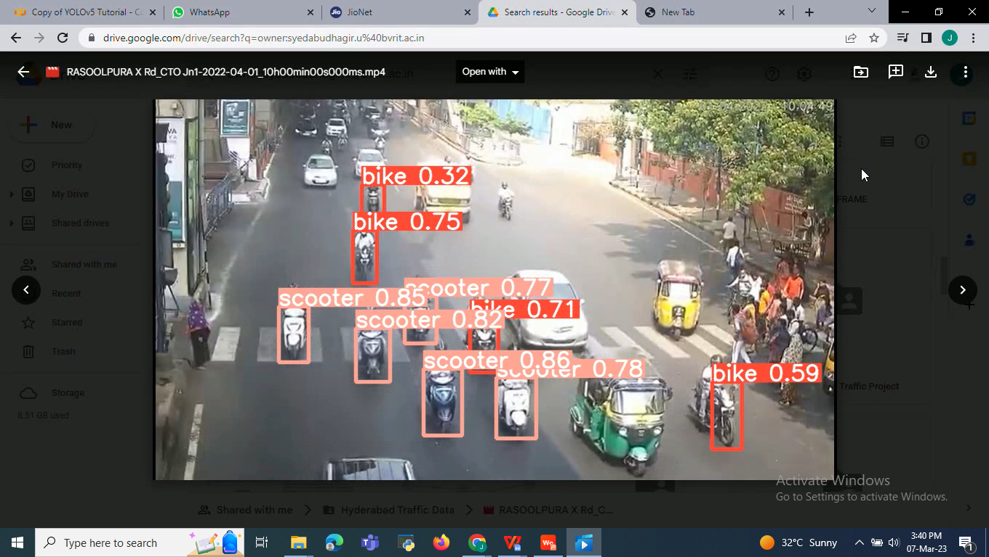
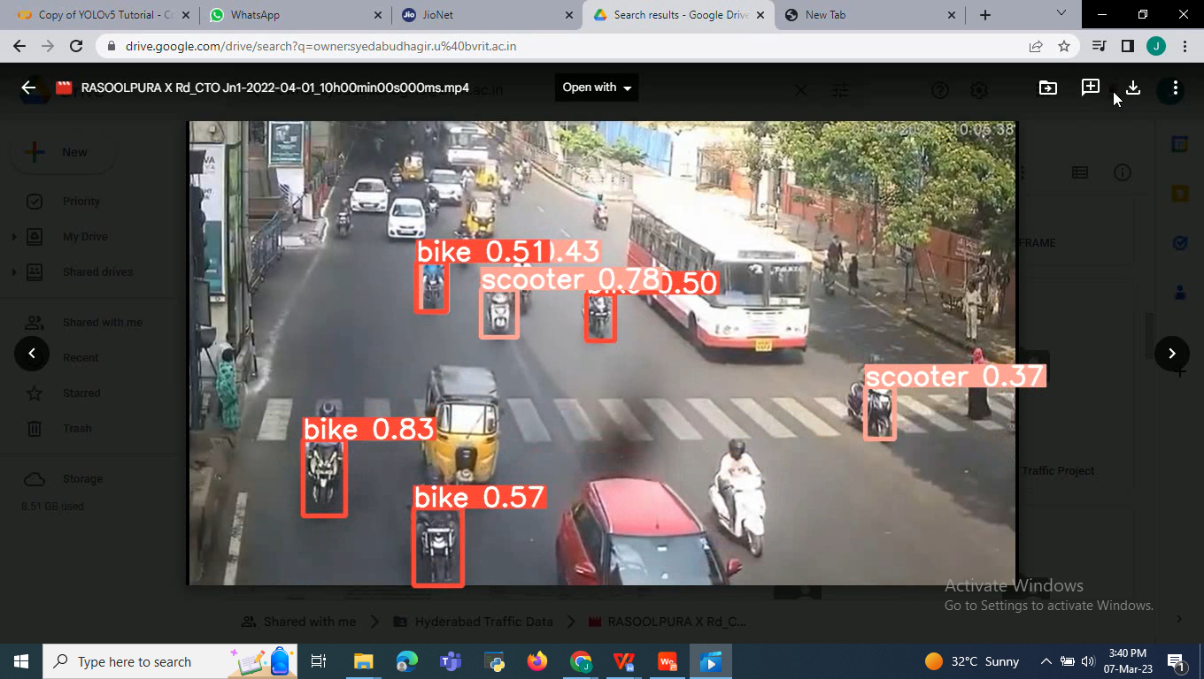

Slide 27
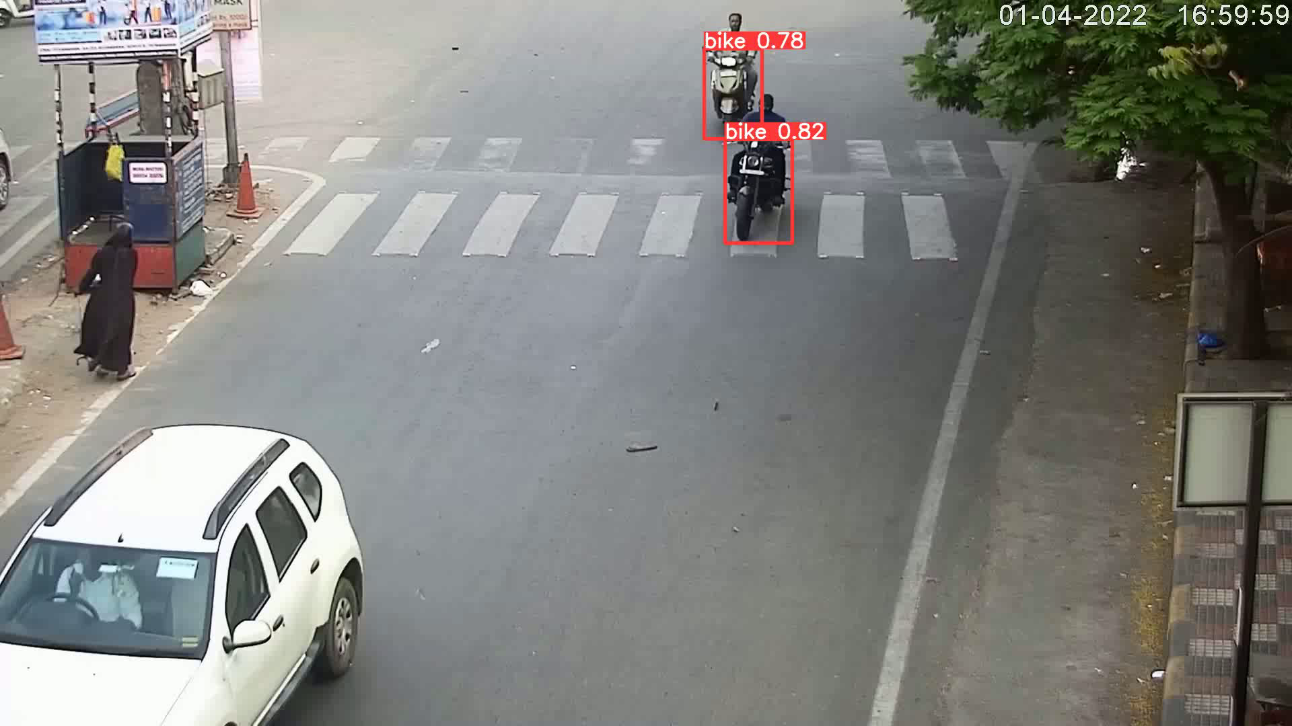
Output Video

Slide 28
References
Masurekar, O., Jadhav, O., Kulkarni, P., & Patil, S. (2020). Real time object detection using YOLOv3. International Research Journal of Engineering and Technology (IRJET), 7(03), 3764-3768.
Mao, Q. C., Sun, H. M., Liu, Y. B., & Jia, R. S. (2019). Mini-YOLOv3: real-time object detector for embedded applications. Ieee Access, 7, 133529-133538.
Kumari, N., Ruf, V., Mukhametov, S., Schmidt, A., Kuhn, J., & Küchemann, S. (2021). Mobile eye-tracking data analysis using object detection via YOLO v4. Sensors, 21(22), 7668.
T. -H. Wu, T. -W. Wang and Y. -Q. Liu, "Real-Time Vehicle and Distance Detection Based on Improved Yolo v5 Network," 2021 3rd World Symposium on Artificial Intelligence (WSAI), Guangzhou, China, 2021, pp. 24-28, doi: 10.1109/WSAI51899.2021.9486316.
Rajendran, S. P., Shine, L., Pradeep, R., & Vijayaraghavan, S. (2019, July). Real-time traffic sign recognition using YOLOv3 based detector.

Slide 29
Faruque, M. O., Ghahremannezhad, H., & Liu, C. (2019). Vehicle classification in video using deep learning. Machine Learning and Data Mining in Pattern Recognition, MLDM, 117-131.
Al-Batat, R., Angelopoulou, A., Premkumar, S., Hemanth, J., & Kapetanios, E. (2022). An end-to-end automated license plate recognition system using YOLO based vehicle and license plate detection with vehicle classification. Sensors, 22(23), 9477.
Zuraimi, M. A. B., & Zaman, F. H. K. (2021, April). Vehicle detection and tracking using YOLO and DeepSORT. In 2021 IEEE 11th IEEE Symposium on Computer Applications & Industrial Electronics (ISCAIE) (pp. 23-29). IEEE.
A. Amrouche, Y. Bentrcia, A. Abed and N. Hezil, "Vehicle Detection and Tracking in Real-time using YOLOv4-tiny," 2022 7th International Conference on Image and Signal Processing and their Applications (ISPA), Mostaganem, Algeria, 2022, pp. 1-5, doi: 10.1109/ISPA54004.2022.9786330.
Maity, M., Banerjee, S., & Chaudhuri, S. S. (2021, April). Faster r-cnn and yolo based vehicle detection: A survey. In 2021 5th international conference on computing methodologies and communication (ICCMC) (pp. 1442-1447). IEEE.
Panetta, Karen, et al. "Artificial Intelligence for Text-Based Vehicle Search, Recognition, and Continuous Localization in Traffic Videos." AI 2.4 (2021): 684-704.

Slide 30
Du, Yunhao, et al. "Strongsort: Make deepsort great again." arXiv preprint arXiv:2202.13514 (2022).
Wu, Tian-Hao, Tong-Wen Wang, and Ya-Qi Liu. "Real-time vehicle and distance detection based on improved yolo v5 network." 2021 3rd World Symposium on Artificial Intelligence (WSAI). IEEE, 2021.
Zhou, Jie, Dashan Gao, and David Zhang. "Moving vehicle detection for automatic traffic monitoring." IEEE transactions on vehicular technology 56.1 (2007): 51-59.
Kumar, Chethan, and R. Punitha. "Yolov3 and yolov4: Multiple object detection for surveillance applications." 2020 Third international conference on smart systems and inventive technology (ICSSIT). IEEE, 2020.
Nguyen, Huy Hoang, et al. "Yolo based real-time human detection for smart video surveillance at the edge." 2020 IEEE Eighth International Conference on Communications and Electronics (ICCE). IEEE, 2021.
Ju, Moran, et al. "The application of improved YOLO V3 in multi-scale target detection." Applied Sciences 9.18 (2019): 3775.

Slide 31
Adarsh, Pranav, Pratibha Rathi, and Manoj Kumar. "YOLO v3-Tiny: Object Detection and Recognition using one stage improved model." 2020 6th International Conference on Advanced Computing and Communication Systems (ICACCS). IEEE, 2020.
Yu, Jimin, and Wei Zhang. "Face mask wearing detection algorithm based on improved YOLO-v4." Sensors 21.9 (2021): 3263.
Diwan, Tausif, G. Anirudh, and Jitendra V. Tembhurne. "Object detection using YOLO: challenges, architectural successors, datasets and applications." Multimedia Tools and Applications (2022): 1-33.
Roh, Myung-Cheol, and Ju-young Lee. "Refining faster-RCNN for accurate object detection." 2017 fifteenth IAPR international conference on machine vision applications (MVA). IEEE, 2017.

